Slide 1
Park Place Homes
22.08.18
Dave Owen
owendr.parkplace@gmail.com
Nello Villaryoa
nav.parkplace@gmail.com
Quinn Van Order
qvanorder.parkplace@gmail.com

Slide 2
Agenda
2022 Decisions
2022 Events
Mr. Welch Lawsuit Update
Finances
Pending Repairs
Roof Report
Reserve Report
The Future
Q&A
Open forum

Slide 3
2022 Decisions
4/14/2022 | As per advice from Valerie at Condo Law, we have agreed to counter Mr. Welch's offer of 38k at 98-100k, expecting to be negotiated down. We have authorized Valerie to settle in the range of 55-75k without needing further consent from the board to minimize back and forth.
4/15/2022 | We agreed to pursue a reserve study by "Association Reserves" @ $2590, enabling us to make informed decisions about maintenance prioritization and budgeting.
4/22/2022 | Agreed to spend $305 to gain membership to WSCAI for the purpose of obtaining training materials on how to best operate a HOA. Will reassess if membership has value prior to renewal next year.
4/27/2022 | Agreed to sign onto "loyalty program" for reserve reports to freeze rates for next 3 years allowing for yearly reports. Will reassess at end of 3 year period to determine if this added value - $1400 per year
4/28/2022 | Agreed to $856.38 estimate for gutter cleaning from "Window Cleaning & More"
5/9/2022 | Approved draft minutes from meeting in January to be finalized and transmitted to association
5/10/2022 | Approved spending $140 to remove couch dumped next to dumpster facilities
5/24/2022 | Approved to spend an estimated $3,975 on roof inspection with J2
6/29/2022 | Approved Settlement for $63,436.49 with Mr. Welch

Slide 4
2022 Events
1/25/2022 | Yearly meeting held, board members elected
2/24/2022 | Budget ratified, 10% increase
5/3/2022 | Fire alarm inspection - passed
5/10/2022 | Couch abandoned by dumpsters removed, unbudgeted $140 expense.
5/12/2022 | Gutters cleaned
6/10/2022 | Reserve Report Inspection
6/22/2022 | Roof Inspection

Slide 5
Mr. Welch lawsuit update
Settling for $63,436.49
Currently processing, not a done deal. No guarantees until check clears.
Money for repairs and reserve payback

Slide 6
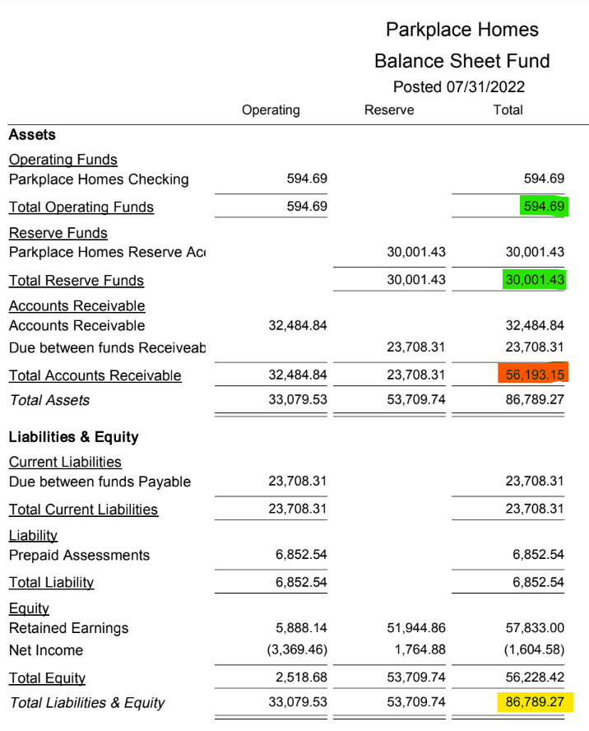
Finances

Slide 7
Pending Repairs
Storage Area
Roof

Slide 8
Roof Report
Broken vents
Vegetation in contact with building
Nearing end of life ~2-3 years
Report contract includes next steps meeting with J2.
Envelope Inspection

Slide 9
Reserve Report
What are reserves?
What is a reserve report?
Why is this important?

Slide 10
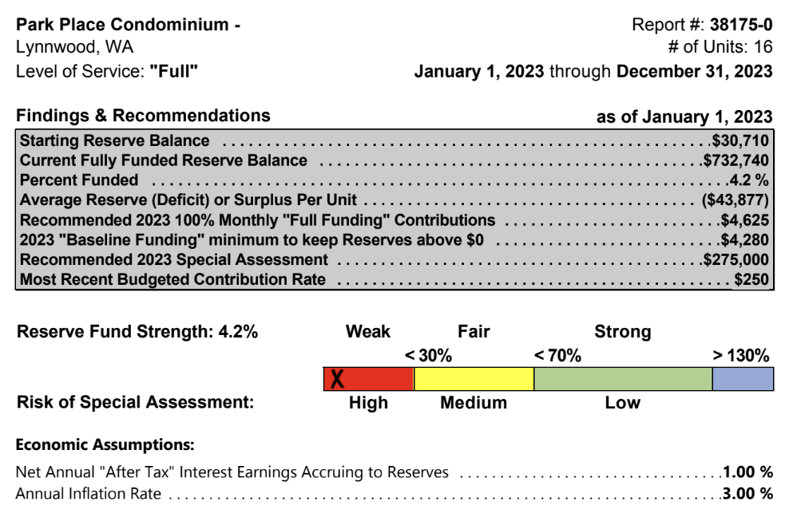
Reserve Report - Executive Summary

Slide 11
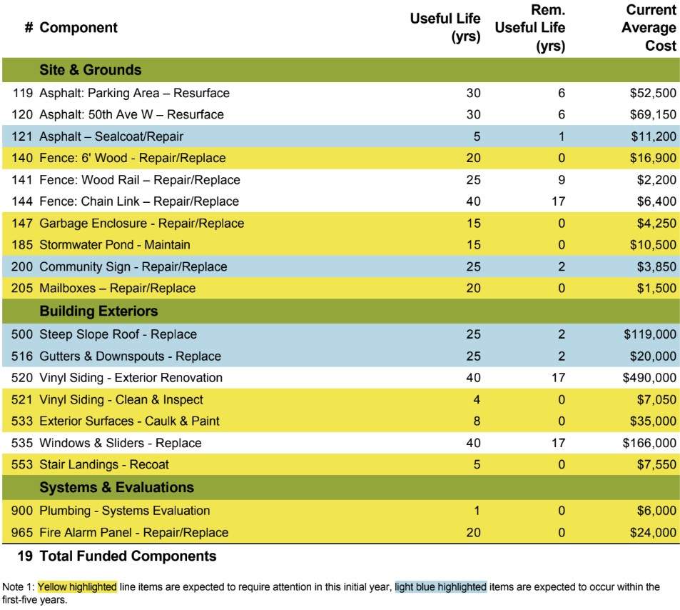
Reserve Report -
Pending Repairs

Slide 12
The Future
Avoid special assessment
Yearly reserve contribution is 3.6k
Roof has 2-3 years of life left
30 years to pay for roof at 3k rate
Baseline reports, gather more data
Envelope Inspection
Higher Quality Roof
Budget adjustments - water
Accepting full funding recommendation from reserve report
Reassess at next years reserve report.

Slide 13
The Future - Bottom Line
2022 Budget - Minus Reserves | $68,602.59
2022 Budget - Reserves | $3,600.00
2022 Budget - Total | $72,202.59
2023 Budget +10% Estimate - Minus Reserves | $75,462.85
2023 Budget +10% Estimate - Reserves | $55,500.00
2023 Budget +10% Estimate - Total | $130,962.80
2023 Estimated Increase | 81.38%
Unit | % | 22 Monthly | 23 Monthly
#101 #201 | 6 | $348.98 | $632.99
#102 #202 | 7 | $403.13 | $731.21

Slide 14
Q&A - Related to meeting topics

Slide 15
Open Forum - any concerns / comments / questions

