Slide 1
Park Place Homes
24.09.06 Board Meeting

Slide 2
Resources
parkplacelynnwood.com - Please Subscribe!
hoainsights.org - Highly informative podcast

Slide 3
Regular Meetings
6pm first Monday of each month
Plan to have meeting packet 1 week prior to each meeting
Plan to vote on quotes in each meeting

Slide 4
Dryer Vent Cleaning - $1149
September 10th starting at 9am
Unit access is NOT required
Call them directly to schedule extra interior cleaning ($40) 425-398-5001
Continuing existing vendor relationship, did high quality work previously.

Slide 5
Fence - $1680
City of Lynnwood code enforcement didnt like our fence
We fixed the portions of concern via Jack, our Nash “handyman”
We opted to not replace the entire fence at this time

Slide 6
Pest Control - VOTE
We ask all residents to refrain from putting food outside.
This has resulted in rats digging around the foundation of 19730.
Quotes:
  Quote #1 ‘Parker Eco Pest Control’ $1322 Per Year ($330*4 quarters)
  Quote #2 ‘Eagle Pest Eliminators’ $2305 Per Year ($685 + ($135*12 months))
  Quote #3 ‘4 Seasons Pest Control’ $2,428 Per Year ($635.95 + ($447.93*4 quarters))
NOTE: Quote #3 was sent over in a service agreement after the meeting packet was transmitted, now including sales tax in the calculations.

Slide 7
Concrete - $3318
Concrete remediation was budgeted for ‘24 and has been completed
Pursued 3 quotes, one vendor opted to not bid
Quotes
  Quote #1 H & J $1205
  Quote #2 Jireh Asphalt & Concrete $3318
Opted for specialist company vs cheaper generalist

Slide 8
Snow - VOTE
Full details of proposal in meeting packet
Prior snow mitigation has proven problematic to forecast
To control costs we propose
  A “pay per plow” service ~$800 per
  Purchasing a Snow blower ~$1300
  Purchasing a wheeled salt spreader ~$280
  Purchasing a pallet of ice melt ~$650
Proposal is to authorize up to $2750 in reserve spending for above equipment to account for sales tax and price variance.

Slide 9
Reserve Study
5.2% funded
Next year’s will have new data with 19730 roof

Slide 10
Envelope Inspection - $6250
Inspection completed, full report in meeting packet.
Immediate need to replace all roofs
Need to replace majority of common areas: siding / porches / doors / windows

Slide 11
Litigation
We completed a recent detailed building envelope inspection. We believe there is an immediate need to replace and remediate all roofs.
Beyond the immediate roof need, the report found hidden damage to exterior wall sheathing and framing.
We have previously assessed for the replacement of the 19730 roof.
We have partnered with Stein, Sudweeks & Stein to pursue a wind driven rain claim against our old insurance policies.
Our current insurance is now Farmers insurance
Now that claims are in motion, we are moving to get the 19730 roof replaced in concert with the insurance claims in hopes to recoup costs of repairing hidden damage to said roof upon settlement. This is why we haven't been moving on the roof thus far.
This insurance claim process will likely take 1 to 2 years to complete
Our relationship with Stein, Sudweeks & Stein is on a contingent basis where they take 33% of any income from litigation.

Slide 12
Insurance - Farmers - $9016
As per above slide, Farmers is now our insurance carrier.
Quotes
  American Family - $10,609.00
  Farmers - $8,518 plus Umbrella policy additional 1M over and above the coverage of liability @ $498.00

Slide 13
Roof - VOTE
Assessed $36k
Scope:
  Roof
  6 inch gutters
  Skylight
  Insulation replacement
  Flashing replacement
  Ventilation replacement
  Microbial growth remediation where applicable
Quotes:
  Quote #1 ‘KSR Roofing’ $33,925 + tax (skylights separate)
  Quote #2 ‘State Roofing’ $35,063 + tax (does not include insulation)
  Quote #3 ‘James King’ $19,632 + tax (unfinalized quote, no gutters skylight, or insulation)
  James King & State will not handle insulation.

Slide 14
Basement
Quote from Jack $4880
Basement will be a line item on a budget ‘25 variant to vote in annual meeting
Quote was not available at time of meeting packet, will be posted on site.

Slide 15
Future Plans
We know we need to replace the majority of our exterior surfaces
Post litigation we plan to obtain an engineering budget
With said budget, an association loan will be obtained
The loan will be backed by an assessment which will be spread over the length of the loan
The loan will fund replacing our common areas

Slide 16
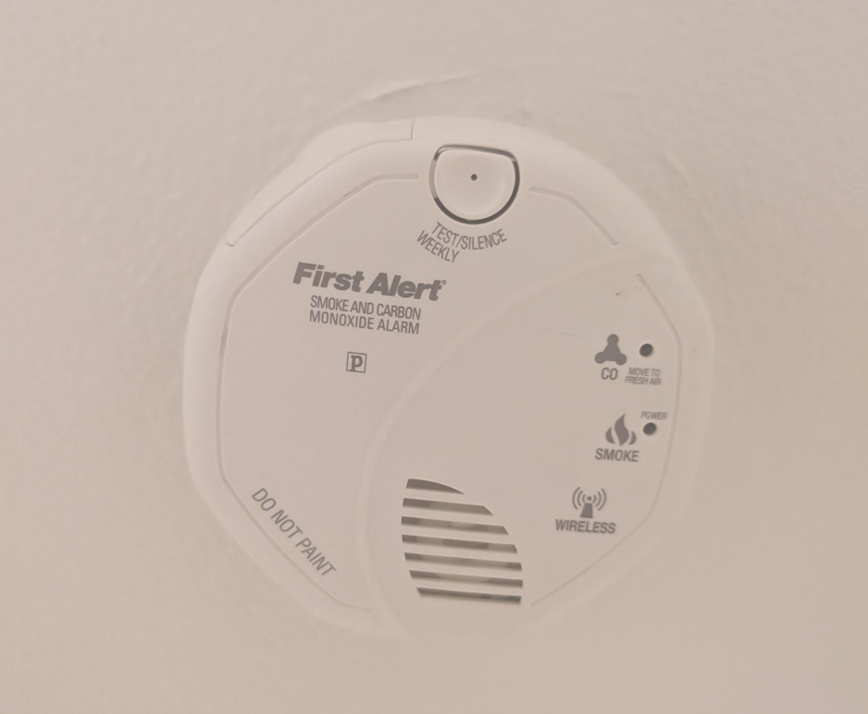
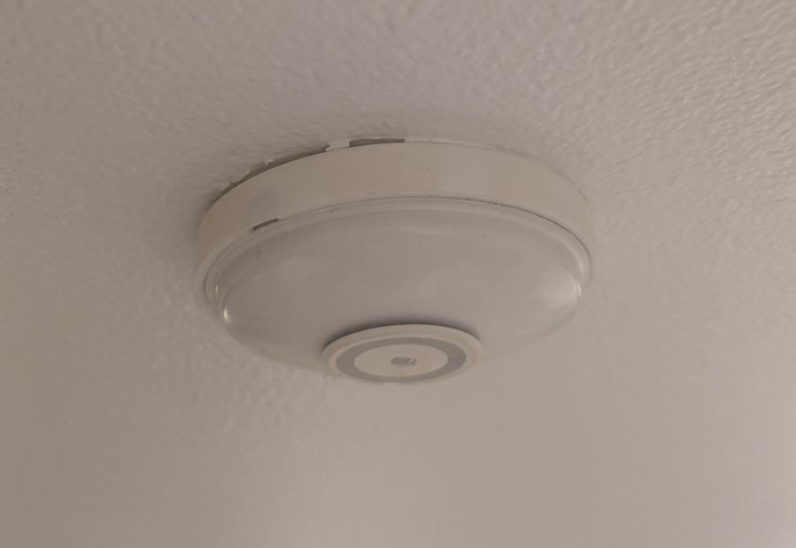
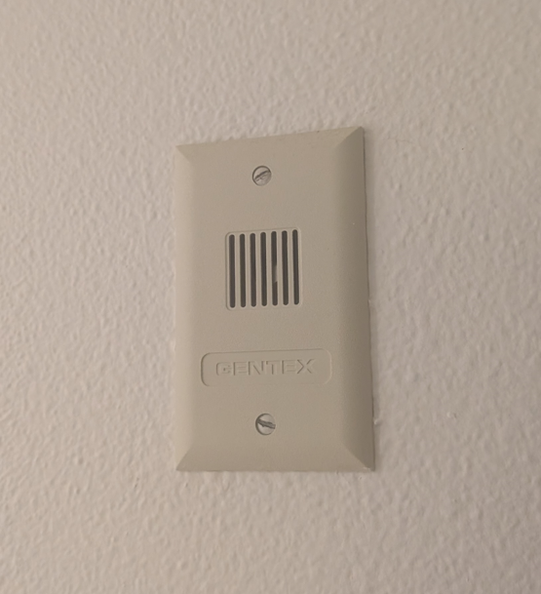
Fire vs Smoke Sensors
Fire Sensor Fire Alarm Siren Smoke Detector
!!!Smoke Detectors have a 10 year lifespan!!!

Slide 17
Final Notes
Parking - Report people using your spot, board is not actively policing it!
Plumbing - Pursuing quotes for rebuilding drainage in 19730, no timeframe.
19730 Building Light - Pursuing w/ Jack
Irrigation - one zone of 3 turned off, needs maintenance
Staggering Board Terms
If you see something, say something!

